Slide 1

Integrating Research and Research Partnerships into Youth Violence Prevention: National Forum for Youth Violence Prevention
Edmund F. McGarrell
Director and Professor
School of Criminal Justice

Slide 2
Integrating Research into Prevention
Background on Action Research & the Role of the Research Partner in Violence Prevention
Connection to a Strategic Problem Solving Approach
Systematic Case Review as a Valuable Tool

Slide 3
Boston Ceasefire to SACSI to PSN
Mid-1990s, Boston Ceasefire emerges as a promising strategy for addressing youth violence (+60% reduction in youth homicides & shootings)
Late 1990s, SACSI developed the strategic problem solving model based on the Boston Ceasefire approach

Slide 4
Boston Ceasefire to SACSI to PSN
Two Aspects to Boston Ceasefire
Focused deterrence, “pulling levers” strategy
Systematic problem solving process
  Multi-agency working group
  Problem solving model
  Police-researcher partnership

Slide 5
Boston Ceasefire: Focus Youth Violence
Problem Analysis
Small Proportion Youths, Involved Gangs & Street Crews
Strategies Focused on those at Highest Risk for Violence

Slide 6
Intelligence-led Problem Solving
Problem Analysis
Strategy
Implementation
Assessment & Feedback

Slide 7
Boston Ceasefire Model of Research Partner
Strategic Approaches to Community Safety Initiative (SACSI)
CeaseFire Chicago
Project Safe Neighborhoods (PSN)
Comprehensive Anti-Gang Initiative (CAGI)
Drug Market Intervention (DMI)
Smart Policing (SPI)
OJJDP Comprehensive Gang Model

Slide 8
Reducing Homicide Risk (Indianapolis)
Note: Each trend is population specific for each graph presented above

Slide 9
Boston & Indianapolis as Examples
It was research that identified the highest risk individuals, groups & contexts
It was the hard work of the task force partners (criminal justice officials, social services, community groups) that then focused strategies on highest risk

Slide 10
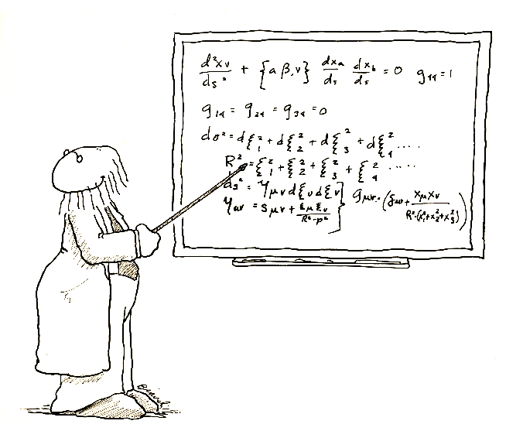

Why a Research Partner? The Role of the Research Partner?

Slide 11
Traditional Research Model
Researchers were outsiders in problem-solving process
  Not involved in problem identification
  Observers, not participants, in program development and implementation
  Involved only as independent evaluators of impact

Slide 12
Action Research Model
Active, ongoing partnership between researchers and practitioner agencies
Use research process to help solve local problems
  Data collection to identify and understand problems
  Strategic analysis to develop targeted interventions
  Program monitoring and feedback for refinement
  Assessment of impact

Slide 13
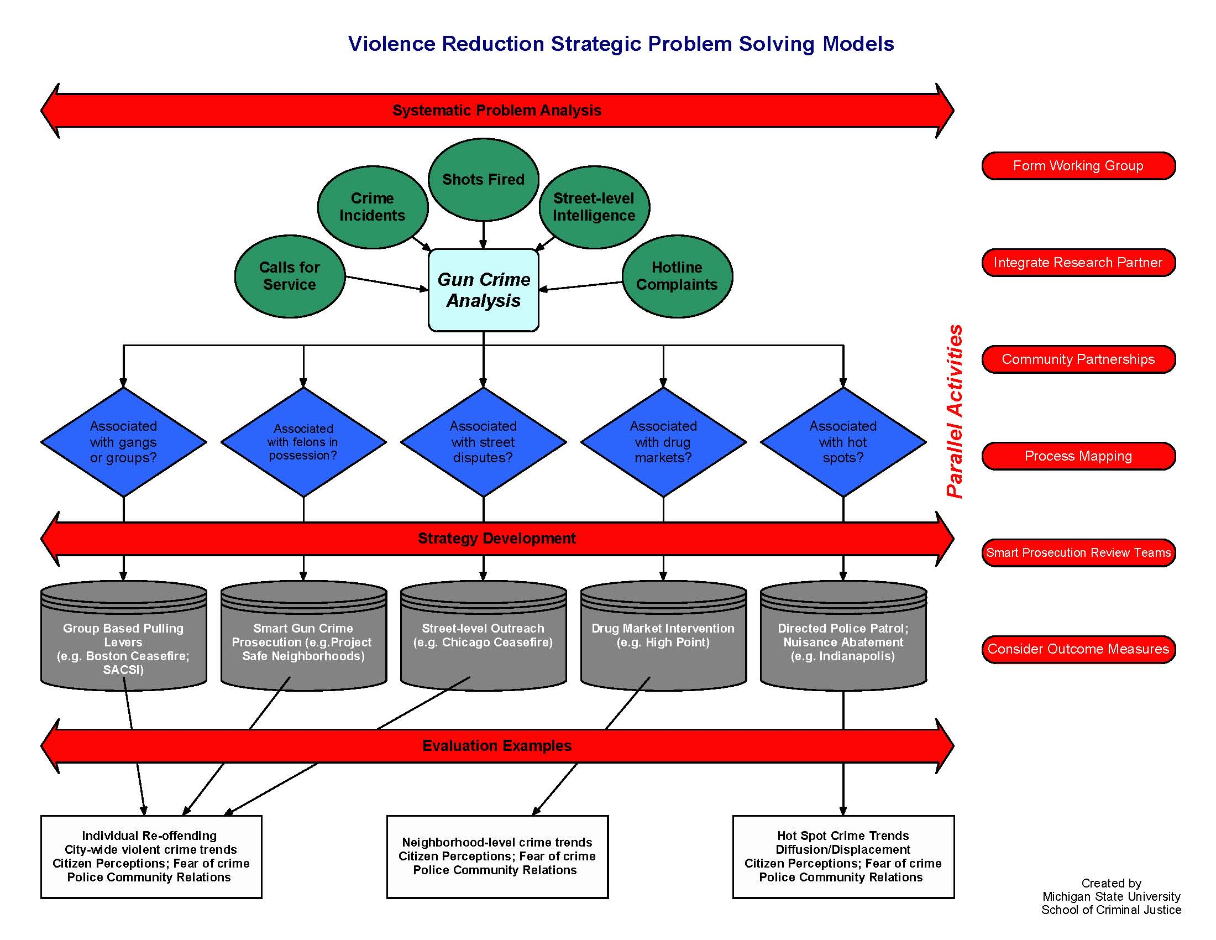

Slide 14
Data-Driven Problem Analysis
Gather data on the selected crime problem, including its sources, victims, offenders, and settings
Analyze the data to identify specific aspects and components of the problem

Slide 15
Focused Interventions & Linking to Evidence-Based Practice
Research can assist:
Develop focused interventions aimed at reducing the specific sources and components of the crime problem
Implement these focused intervention strategies utilizing the resources and expertise of the working group partners
Base interventions on “best” practices & “promising” strategies

Slide 16
Monitoring, Feedback, and Evaluation
Monitor the implementation of the interventions
Provide constant assessment and feedback on the conduct and effects of the interventions
Modify and refine the interventions based on feedback assessments
Evaluate the impacts of the interventions on the service delivery system and on the targeted crime problem

Slide 17
Project Safe Neighborhoods
Nation-wide DOJ program intended to reduce gun crime in America
94 separate programs, one for each US Attorney Office in the 50 states and territories
Based on the Action Research/Strategic Problem-Solving Model
Funding provided for a local research partner to work with each PSN task force
Notes:
9:30am - 9:34am
Describe Project Safe Neighborhoods
A nationwide commitment to reduce gun crime in America
A network of new and existing programs that target gun crime
An opportunity to provide tools and resources at the local and national level to support the network’s efforts
PSN focuses on:Violent organizations and offenders, especially armed career criminals; Illegal gun traffickers; and Brady denials/false statement cases
2. Give the history of Project Safe Neighborhoods
On May 14, 2001, President George W. Bush and Attorney General John Ashcroft unveiled “Project Safe Neighborhoods”, a new, comprehensive, strategic approach to gun law enforcement – an approach that targets gun crime and violent offenders in an effort to make our streets and communities safer. The Administration’s plan calls upon each US Attorney to implement this national initiative, working in partnership with communities and state and local law enforcement agencies. The plan envisions an invigorated enforcement effort that either builds on the successful programs already in place or, through new resources and tools, creates effective gun violence reduction programs.

Slide 18
PSN Implementation Measures
Partnerships
Research
Integration into
Implementation
Strategic
Planning
Enhance
d
Federal
Prosecution
Zimmermann, 2006
Notes:
To begin to talk about that construction, let us turn to the dependent variables.
Five elements of policy adoption are mandates, however, two elements – outreach and training – were documented by all districts and hence became a constant in the model.
Therefore, we will focus on the areas of
Collaborative implementation of programs
research integration into a strategic planning process and
Enhanced federal prosecution

Slide 19
Key Findings
Integration of research was positively associated with other implementation components
More effective implementation led to reduced violent crime

Slide 20
PSN Impact on Violent Crime
Level of PSN Dosage | PSN Target Cities | Non-target Cities
Low | -5.3% | +7.8%
Medium | -3.1% | <-1.0%
High | -13.1% | -4.9%
 | -8.89% | -0.25%

Slide 21
Evaluating Impact
Pulling levers studies
SACSI
PSN
CAGI
DMI
CeaseFire Chicago
  Common finding, when implemented with fidelity & intensity appears to have a violence reduction impact

Slide 22
Implementation is Key
PSN findings suggest that an effective police-research partnership supports effective implementation

Slide 23
The Systematic Incident Review
Boston, SACSI, PSN (many), DMI sites have utilized to understand the problem
Borrowed from public health mortality reviews
May focus exclusively on homicides
May focus on homicides & shootings
May focus on other “problems” (e.g., gangs, street robberies)
Tap into rich street intelligence

Slide 24
Incident Review: Unpacking the Problem
3 things to unpack
The Facts
  (Who? What? When? Where?)
The Context
  (Surrounding circumstances)
The Explanation
  (Why?)

Slide 25
Crime Incident Reviews
Multi-agency team brought together to review individual incidents
Gather street level knowledge to combine with formal records
Who is involved?
What do we know about where it occurred?
What was the motive?
Are there group connections?

Slide 26
Unpacking the Patterns
Offender
Victim
Crime
Triangle
Crime Triangle
Outside of triangle:
  Offender (Left)
  Victim (right)
  Location (bottom)
Location

Slide 27
Rochester, NY Incident Review
16th and 17th Homicides
Presented by Investigators Dominick & Galetta
From Rochester’s Incident Reviews, Courtesy of Dr. John Klofas, Rochester Institute of Technology, with permission Rochester Police Department
Notes:
4:02pm – 4:14pm
The following 29 slides describe two homicides that were discussed in Rochester’s incident review sessions. Go over the slides at a pace that is appropriate for the interest of the participants. Use the 12 minute time period to go through all the homicide slides.
1. Describe the structure and logistics of Rochester’s homicide review session.
In Rochester, as in several other locations, they conducted incident reviews- detailed reviews of the homicide cases.
They began with a grand review of all homicide cases in a year. Over one long day, they reviewed closed and open cases to identify patterns and important issues across the cases.
Almost 100 people participated from across the criminal justice system: police and prosecutors, probation and parole, ATF, FBI, Sheriff’s department.
About 50 people participate in the ongoing monthly reviews of major cases, including homicides.
Here are some examples of the case presentations done in Rochester

Slide 28
April 28, 2000
Friday
12:01 P.M.
113 Columbia Ave.
Notes:
This was the date, time and location of the two homicides in 2000.
Friday April 28, 2000
12:01 PM
113 Columbia Ave.

Slide 29
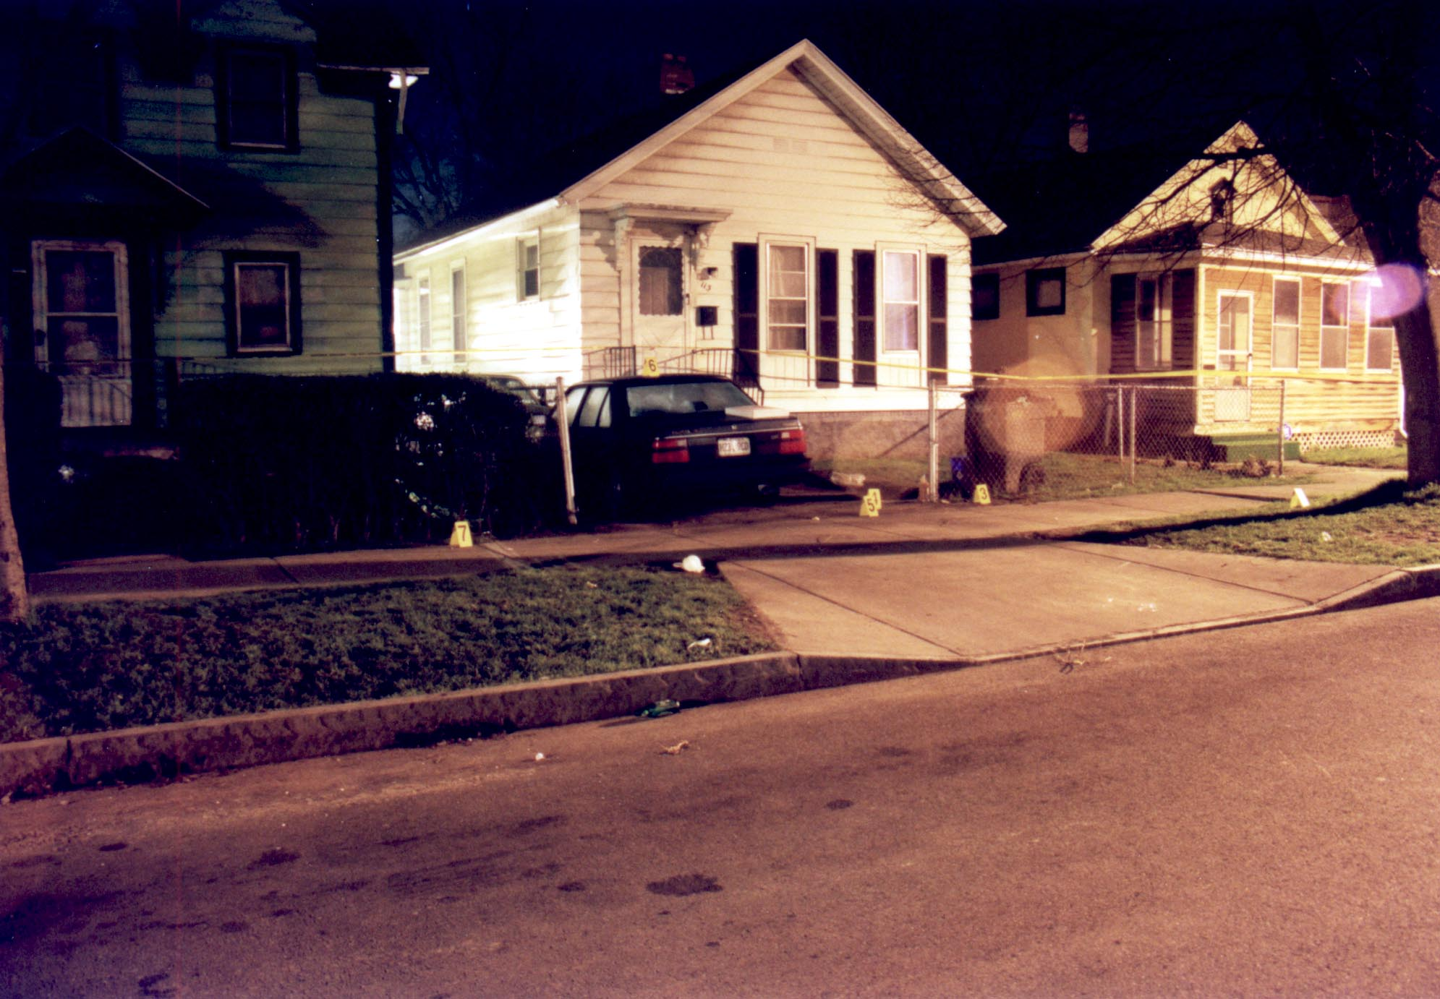
113 Columbia Ave.
113 Columbia Ave.
(Genesee Section)
Residents of location called 911
Notes:
The presentations include GIS information and scene photos as well as data on everyone involved.
In this case, two young men were killed while sitting on this car eating pizza from the box on the trunk.
It occurred on a corner known for drug sales. And it illustrate a problem that has been particularly severe in Rochester- drug selling related homicide.

Slide 30
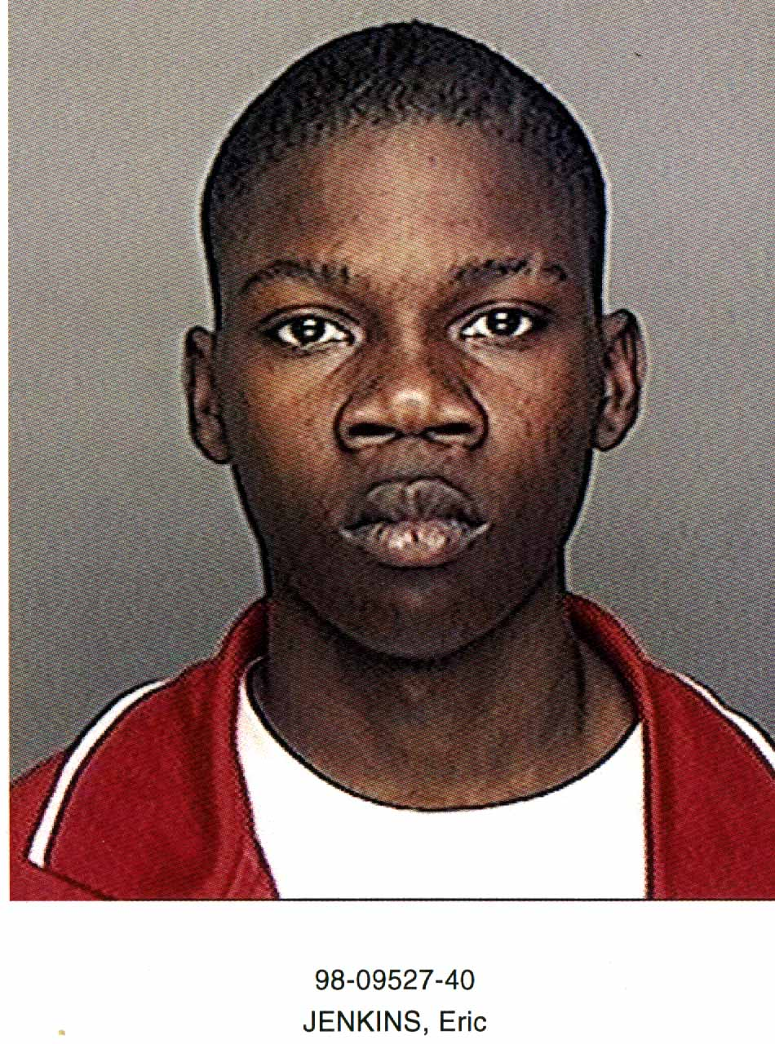

VICTIM
Eric J.
62 Magnolia Ave.
M-B-18
Prior auto theft related arrests
Drug involvement- prior CPSP arrest
Selling drugs at location killed
Died from multiple gunshot wounds
Notes:
This is the profile of one victim.

Slide 31
VICTIM
Will B.
400 Seward St.
M-B-18
No prior arrests
Selling drugs at location killed
Died from multiple gunshot wounds
Notes:
This is the profile of the other victim.

Slide 32

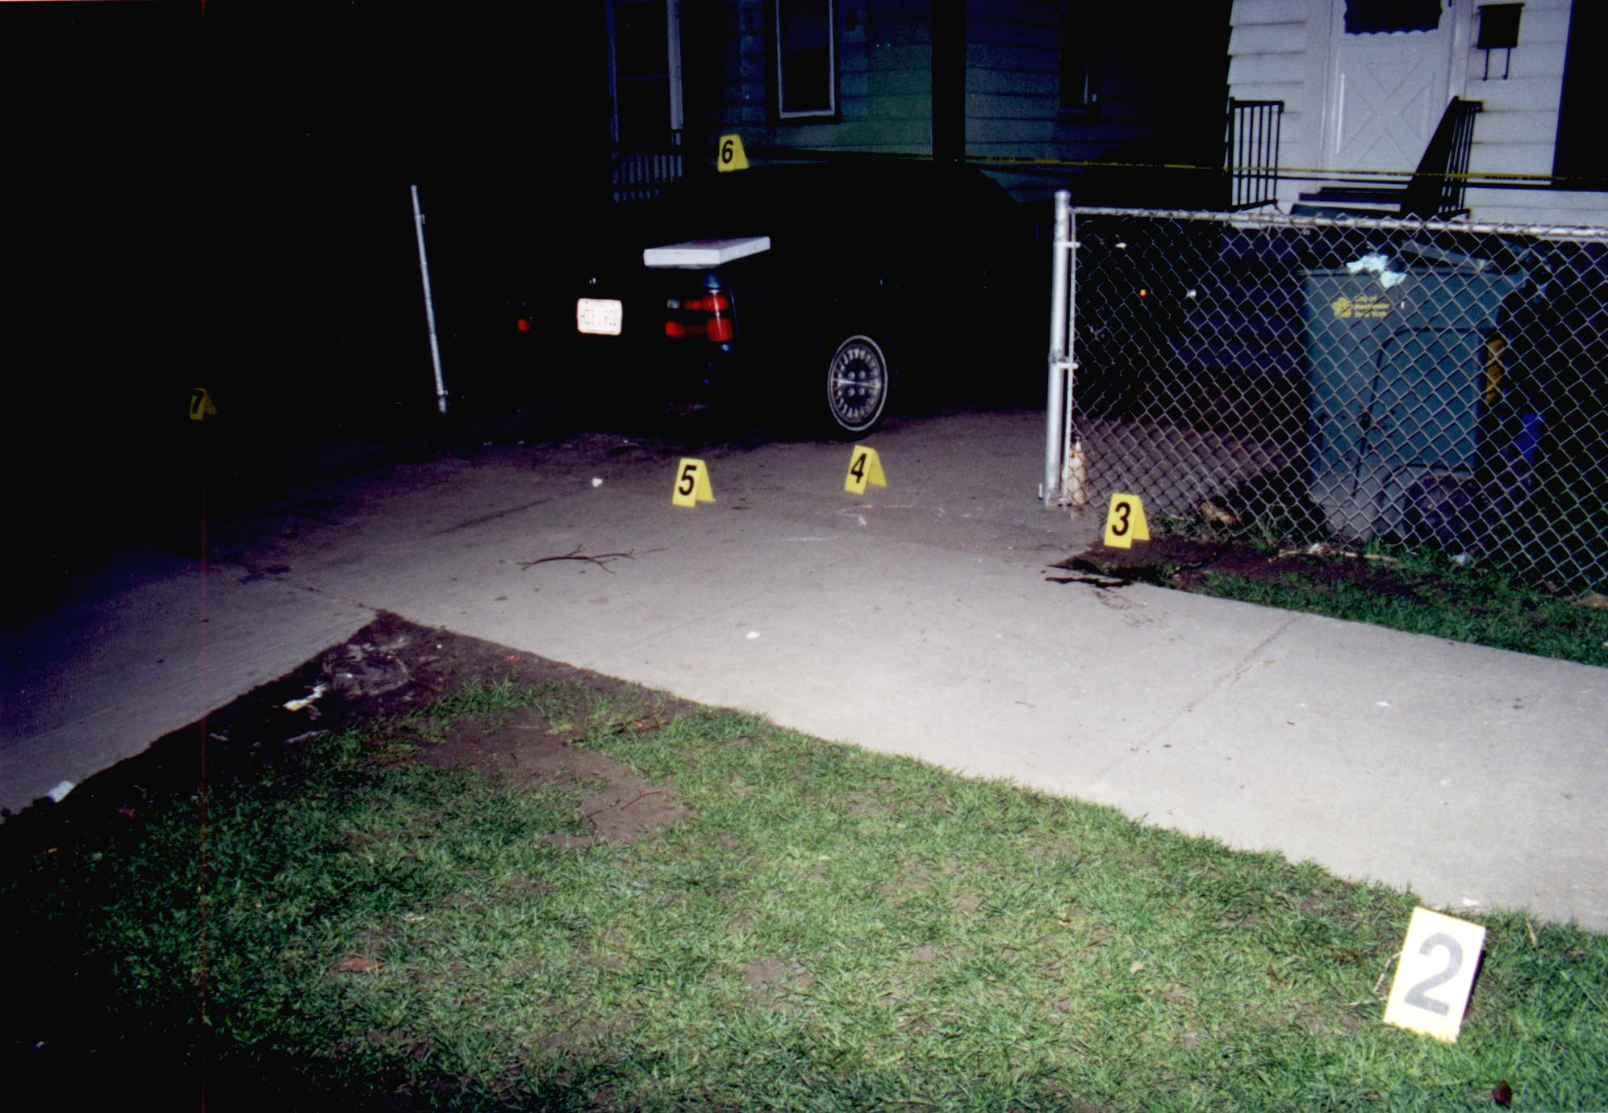
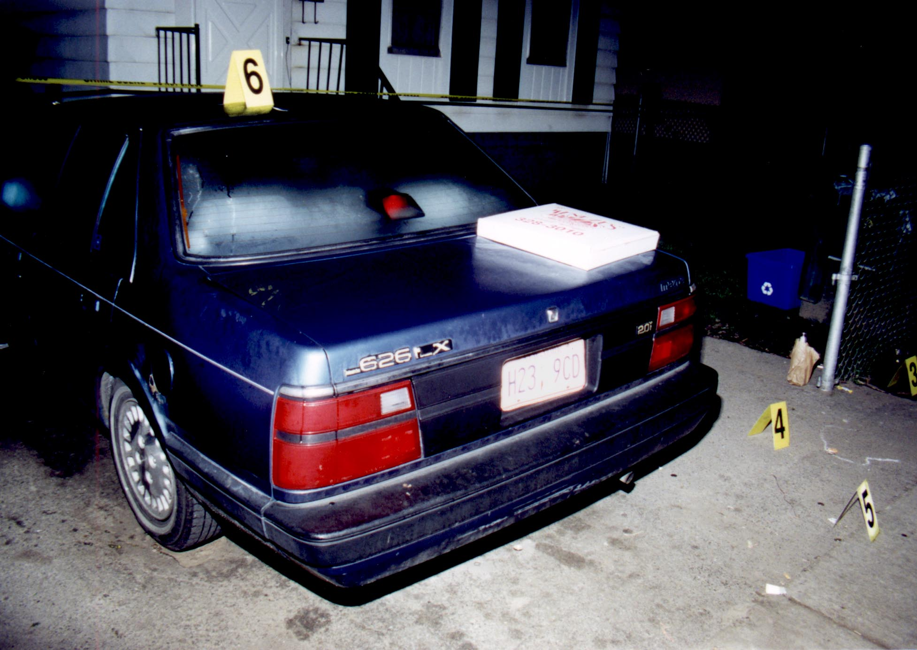
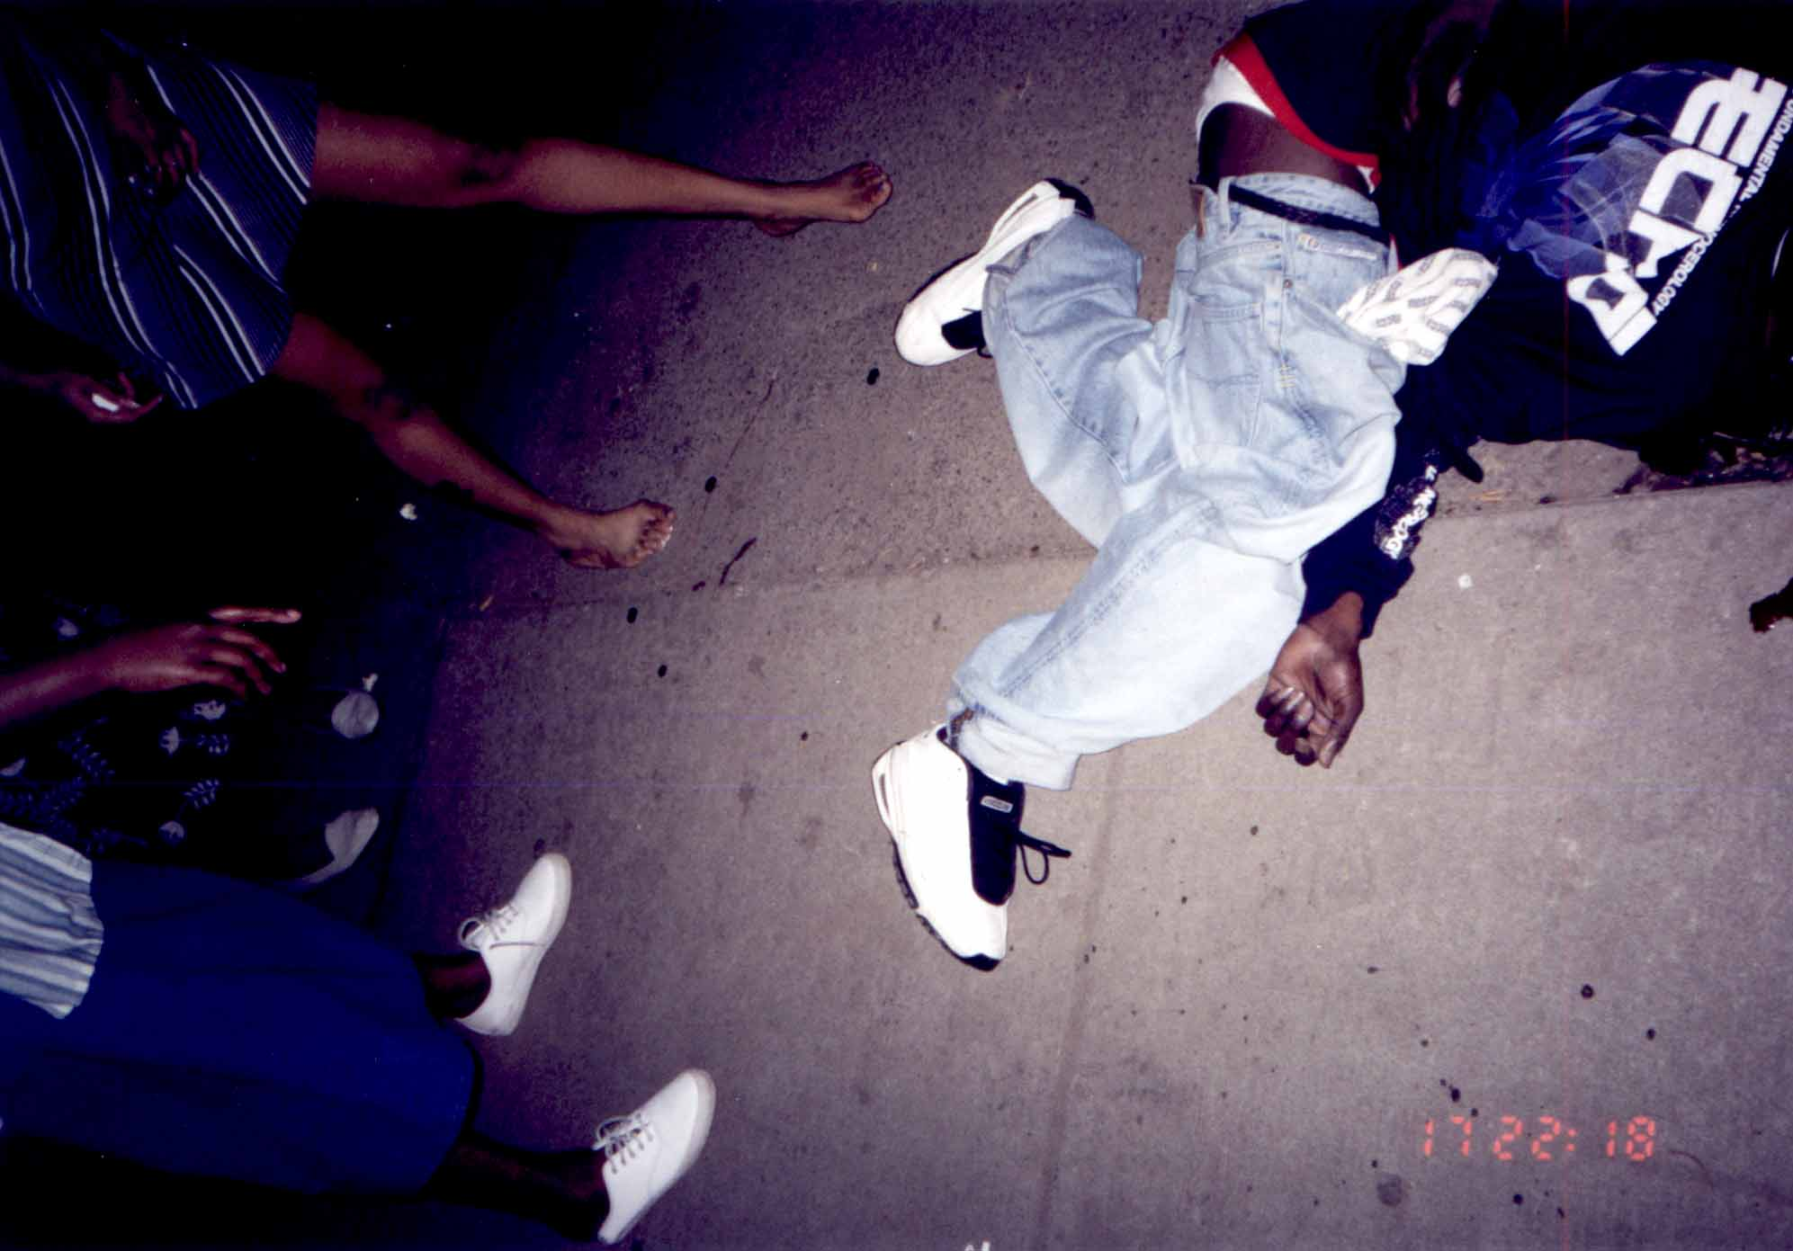
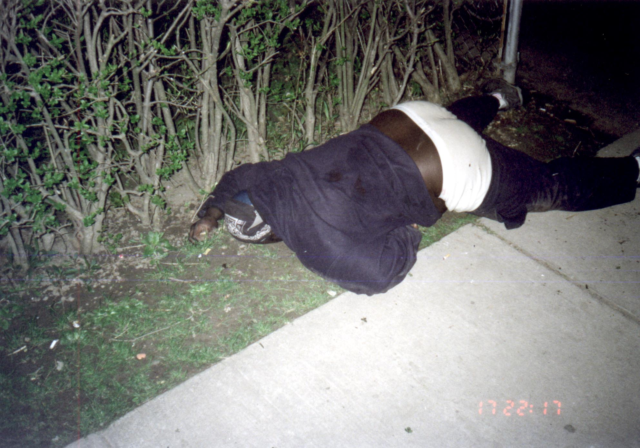
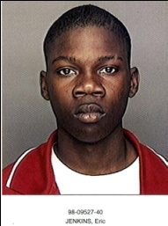
VICTIMS
Will B.
400 Seward St.
M-B-18
No prior arrests
Selling drugs at location killed
Died from multiple gunshot wounds
Eric J.
62 Magnolia Ave.
M-B-18
Prior auto theft related arrests
Drug involvement- prior CPSP arrest
Selling drugs at location killed
Died from multiple gunshot wounds
Eric J.
62 Magnolia Ave.
M-B-18
Prior auto theft related arrests
Drug involvement- prior CPSP arrest
Selling drugs at location killed
Died from multiple gunshot wounds

Slide 33
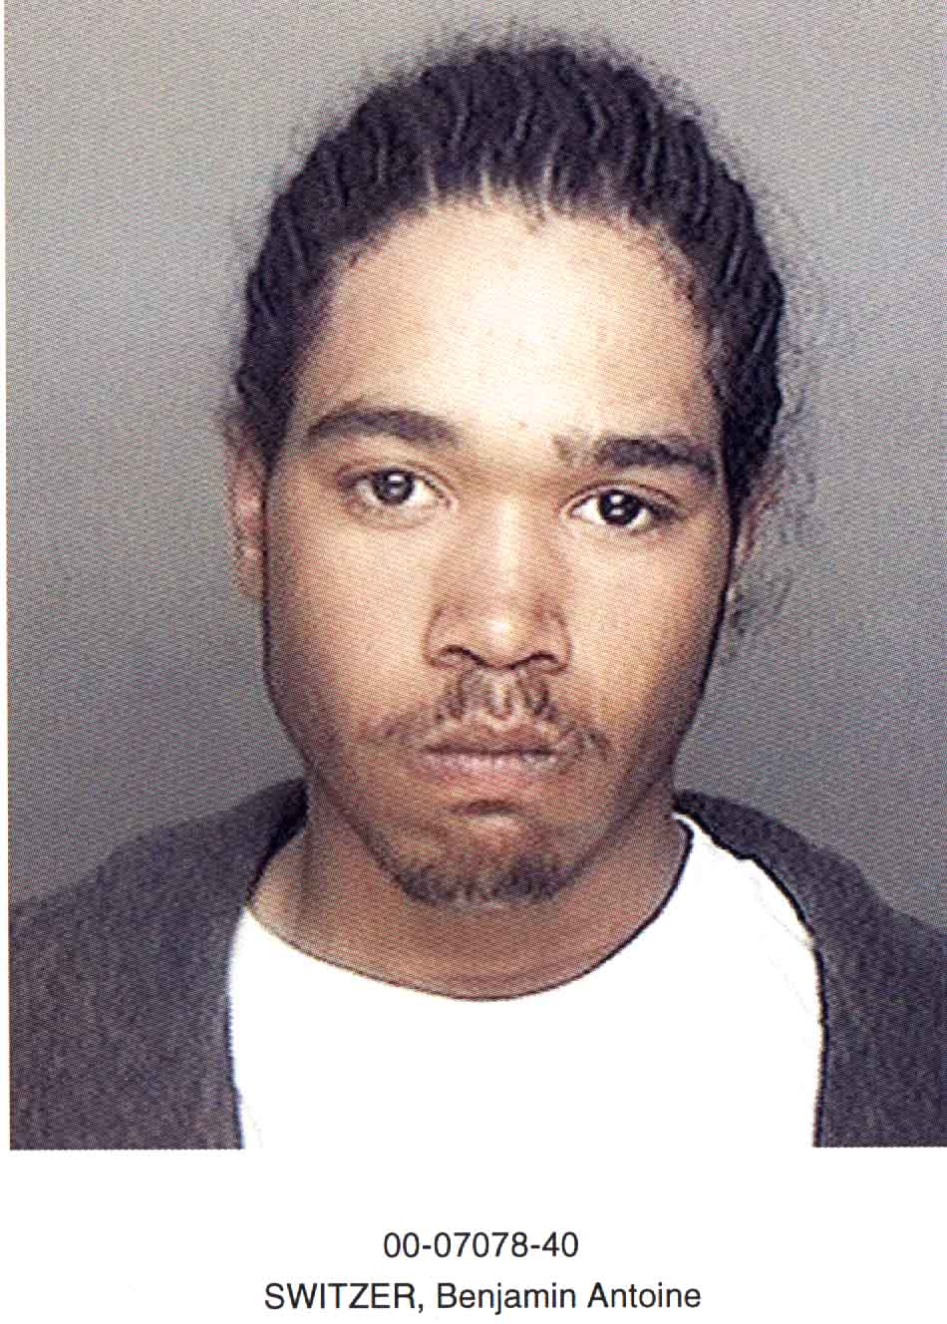
SUSPECT
Benjamin S.
M-B-18
Arrests: CSCS, CPCS,
assault, GL, robbery, unlaw. imprisonment
Drug involvement- FIF’s for drugs
MOTIVE- Robbery
Notes:
This is the profile of one suspect.

Slide 34
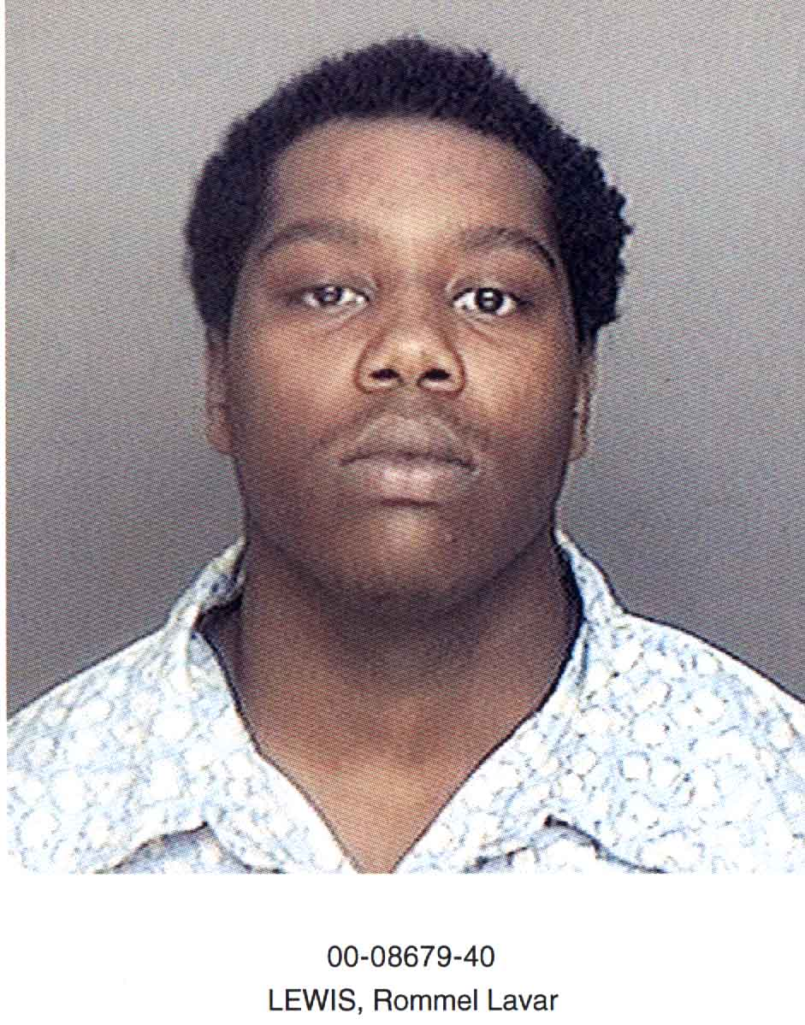
SUSPECT
Rommel “Swift” L.
M-B-18
Arrests: assault, GL, PL, CPSP, crim. poss. Weapon
Suspected of several shootings
Responsible for shooting Tim W. (a possible suspect in Whitney St. homicides)
MOTIVE- Robbery
Notes:
This is the profile of the other suspect.
Lewis did the shooting in the case. It occurred as part of a series of violent crimes he committed around the same time.

Slide 35
Homicide Review Questions
Do you know anything about this case?
What do you know about the victim?
What do you know about any associates of the victim?
Was the victim part of a group of active offenders?
What do you know about the suspect(s)/offender(s)?
What do you know about any associates of the suspect(s)/offender(s)?
Is/was the suspect(s)/offender(s) part of a group of active offenders?
What do you know about the relationship between the victim and suspect(s)/offender(s)?
What do you know about the location of the event?
What do you know about the motive of the case?
Was the incident drug related? How?
What do you think was behind the event? (final summary)?

Slide 36
Information to Intelligence
Incident reviews led to an understanding of two main categories of homicides and gun assaults (Rochester):
Drug house robberies
Disputes, often among individuals with prior experience in the CJ system

Slide 37
What they said: Life History of a Drug House
Crack House: Busted, Closed or Robbed
Activity
Hot Crack House
Weed House
Weight House
Time
Notes:
4:25pm – 4:26pm
1. Describe the chart and how this inmate focus group information can be plotted and useful in strategic interventions.
When the inmates talked about drug house robberies, they indicated that many drug houses get so “hot” that dealers loose control of them. They start selling to friends and friends-of-friends and then more and more strangers come (if the drugs are good). That is when houses are subject to robbery- especially crack houses which is where the money is.

Slide 38
Where drug robbery/murders occur
Notes:
4:26pm – 4:27pm
1. Describe the next steps to use this data.
So the next research task is to try to find ways to prioritize drug enforcement activity according to potential for violence- especially robbery and murder.
So in the universe of all drug houses some are known to the police. Some of those will be “hot” houses and some of those will be robbed and some of the robberies will result in murder. From an intervention perspective it makes sense to look for the hot drug houses as places to intervene.
So to start we needed to come up with an operational definition of what a drug house is and a way to count them and measure their temperature.

Slide 39
Drug House Robberies
Suggests need identify “hot houses” as well as groups involved in drug house robberies
Houses = knock & talks, park police cruiser out front, undercover
Groups = pulling levers, notification, gun carrying directed patrols

Slide 40
Disputes
Many occur over a long period of time (two weeks to a month)
Known throughout neighborhood
Most risky are those involving felons in possession firearm
= Need gather street level intelligence on active disputes in hot zones & craft interventions (e.g., CeaseFire Chicago; knock & talks; gun carrying directed patrols)

Slide 41
Variation on Incident Review
Case Processing Review
  Joint Case Review (PSN = Gun Case Reviews involving AUSA, Local Prosecutor, law enforcement)
  What happens post-arrest? (adapt to youth violence prevention)
    Are high risk youths diverted to services?
    Do they receive services?
    Are they effective?
    What happens to cases deemed necessary for prosecution?

Slide 42
Case Processing Review
Shared understanding, system fixes, accountability

Slide 43
Summary – Incident Reviews
Another tool for understanding specific violence problems
Further Information:
Milwaukee Homicide Review Commission training program (COPS-Sponsored)
http://city.milwaukee.gov/hrc/COPS-National-TrainingTechnica
PSN Case Study on Incident Reviews
http://www.psn.gov/pubs/pdf/PSN_CaseStudy3.pdf

Slide 45
Thank you!

